Slide 1
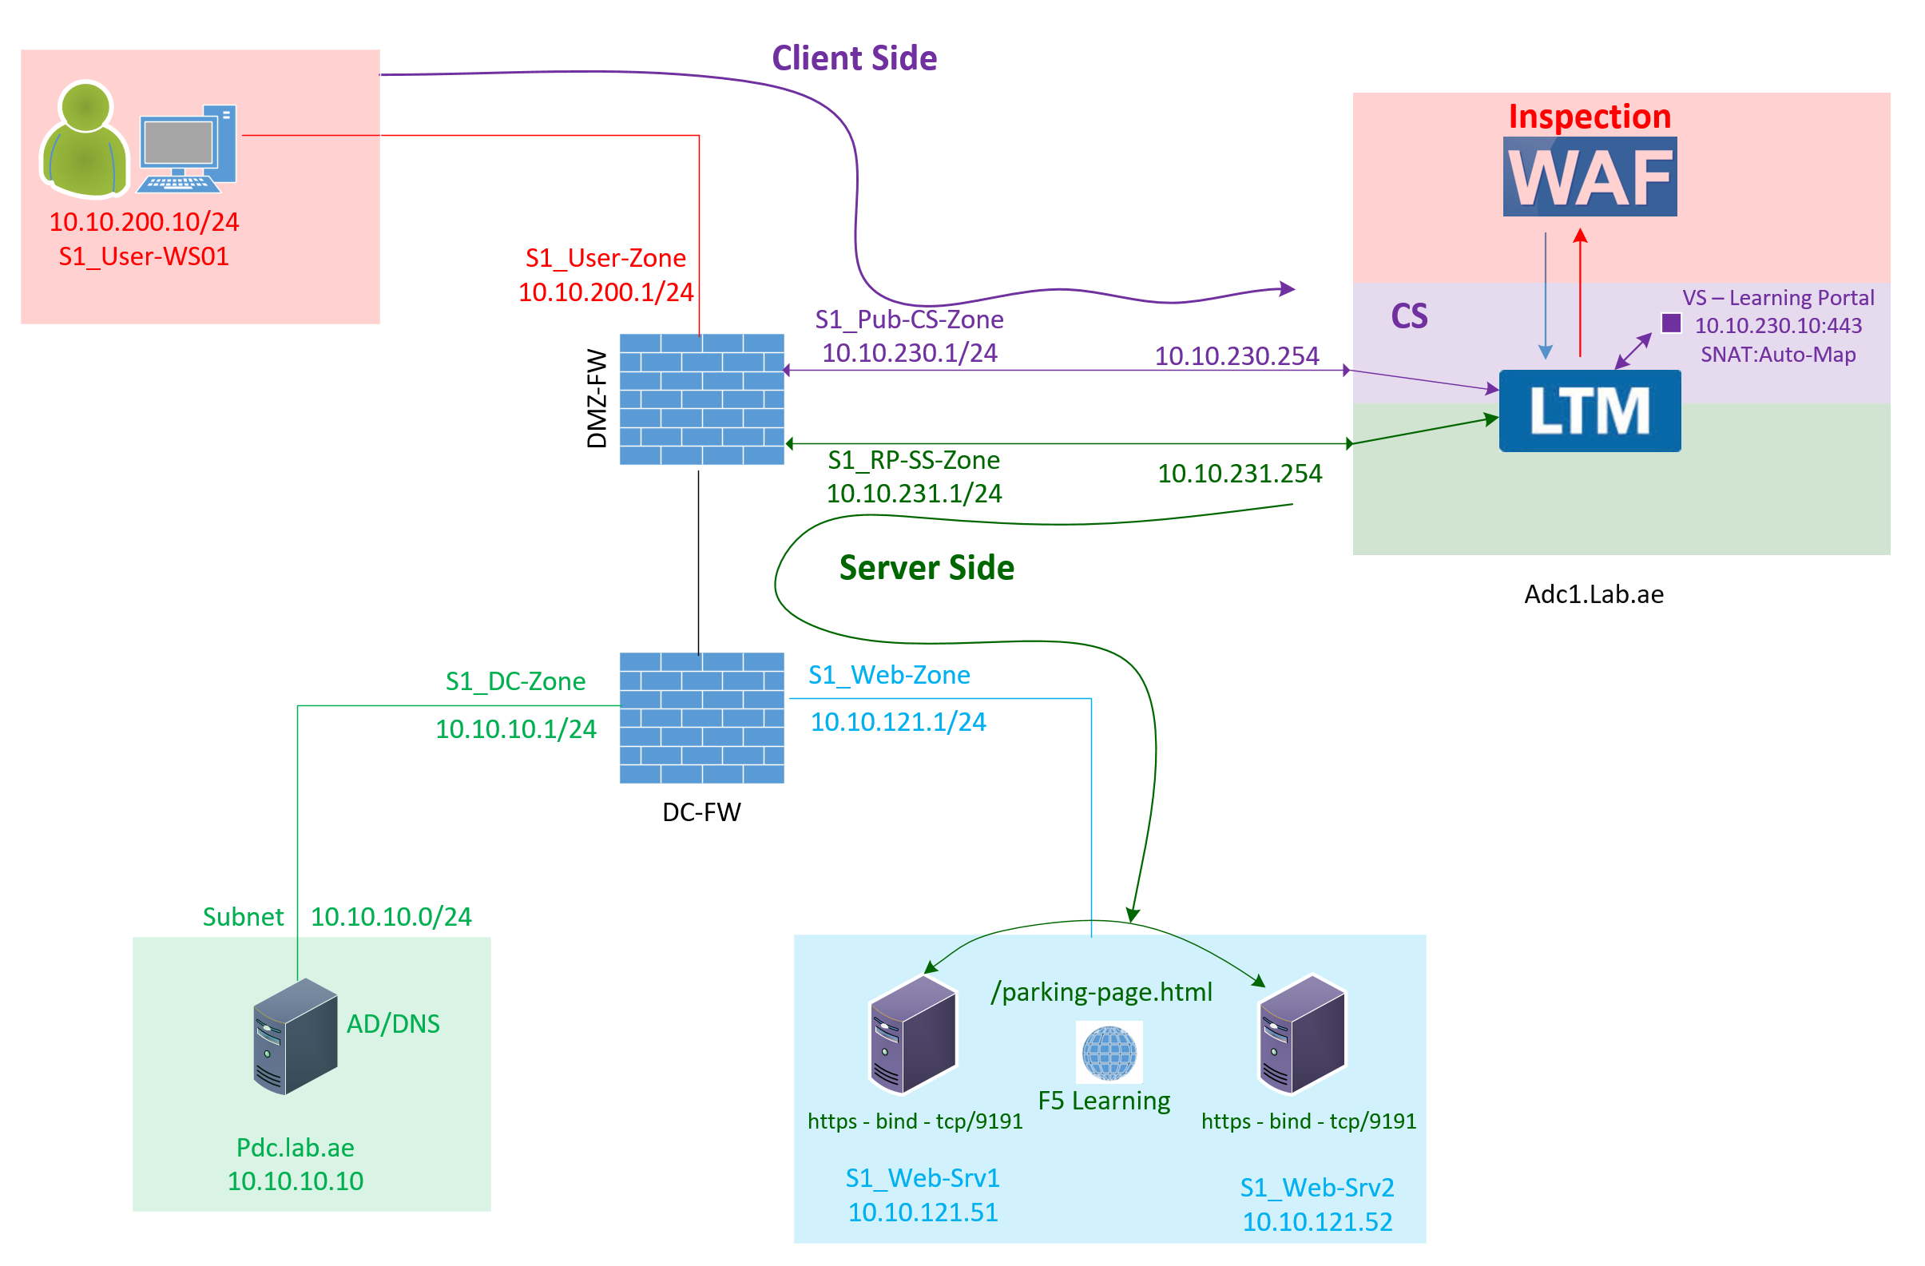

F5 LTM Learning with
Alexander S
Bonus Chapter 06 - Explore and configure the Client-SSL profile and Server-SSL profile in F5 LTM
LAB-WC_Client-SSL_Profile
Generic_Server-SSL_Profile

Slide 2
What is an Client-SSL profile and Server-SSL Profile in F5 LTM?
LAB-WC_Client-SSL_Profile
When F5 load balances the encrypted TLS traffic between the client and backend server,
  The Client SSL and Server SSL profiles are the key for F5 to inspect the traffic at layer 7
Generic_Server-SSL_Profile

Slide 3
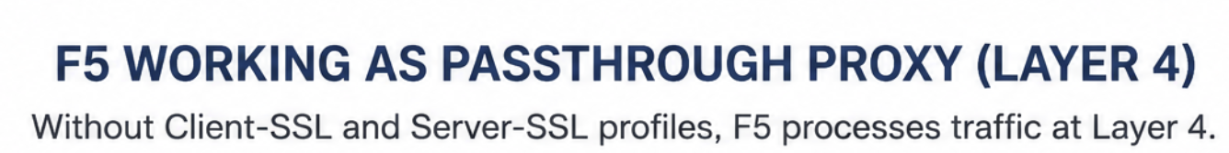
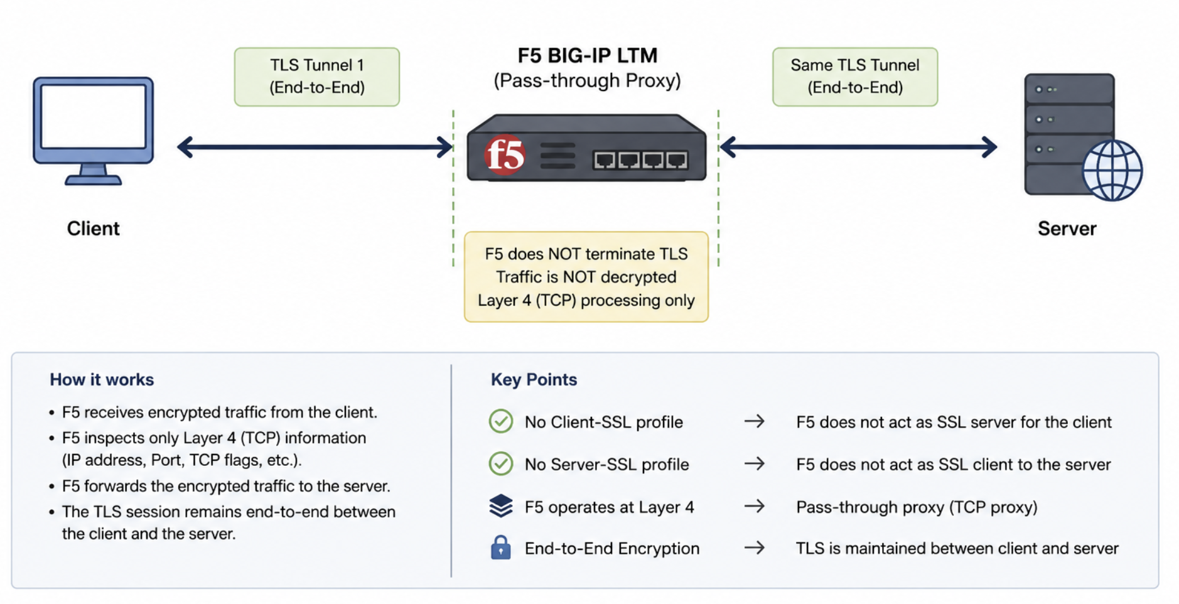
Without Client-SSL and Server-SSL profiles, F5 work as pass-through proxy and process the traffic at layer 4.
No Client SSL
No Server SSL

Slide 4
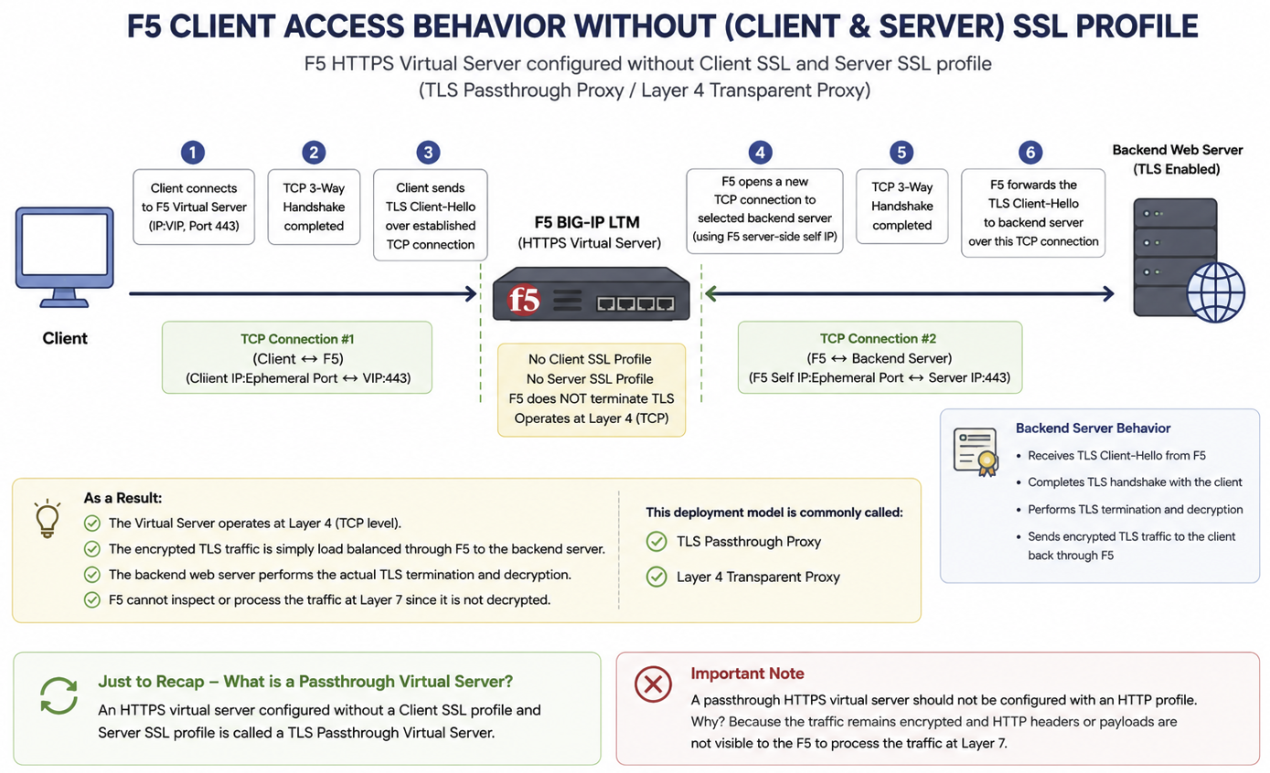
https://learning-portal.lab.ae/
10.10.230.10:443
No Client SSL
10.10.230.10:443
No Server SSL
CS-Self IP : 10.10.230.254
SS-Self IP : 10.10.231.254
10.10.121.51:9191
10.10.200.10
10.10.210.10:48001 10.10.230.10:443
10.10.231.254:48001 10.10.121.51:9191

Slide 5
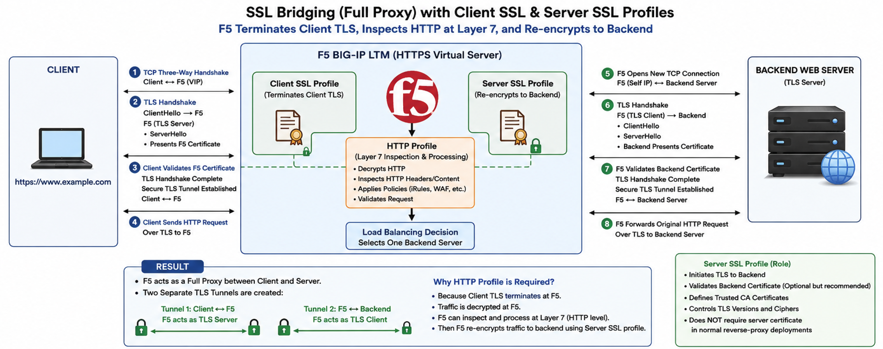
CLIENT ACCESS BEHAVIOR WITH CLIENT & SERVER SSL PROFILES
10.10.230.10:443
F5 act as a TLS Server
F5 act as a TLS Client
10.10.200.10
CS-Self IP : 10.10.230.254
SS-Self IP : 10.10.231.254
10.10.121.51:9191
10.10.210.10:48001 10.10.230.10:443
10.10.231.254:48001 10.10.121.51:9191

Slide 6
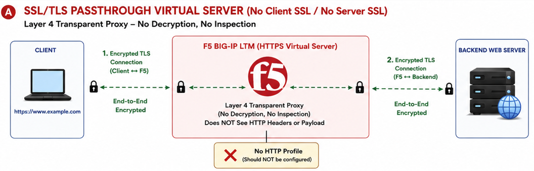
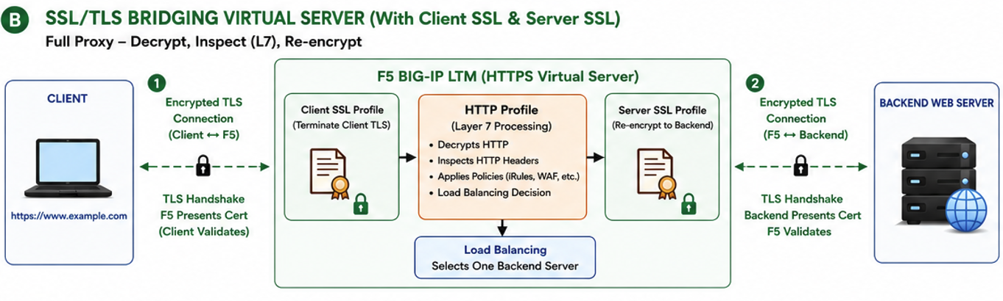
10.10.230.10:443
10.10.200.10
10.10.121.51:9191
10.10.230.10:443
10.10.200.10
10.10.121.51:9191

Slide 7
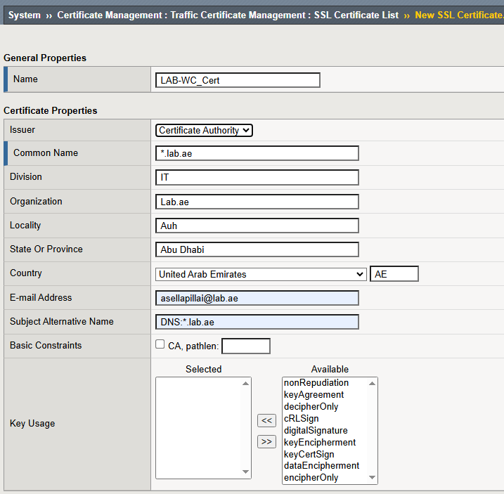
CSR (Certificate Signing Request) template
Configure the Client SSL Profile
CA Signed
Following this video,
https://www.youtube.com/watch?v=7KeUsTiwbfE
I created the Client SSL profile named as
  LAB-WC_Client-SSL_Profile.
Wild Card

Slide 8

Bonus Chapter 06 - Explore and configure the Client-SSL profile and Server-SSL profile in F5 LTM
You can attach the Client SSL profile and Server SSL profile while configuring the SSL Bridging Virtual Server.
I hope this video helped you to understand and configure the Client SSL profile and Server SSL profile in F5.
This brings us to the end of Bonus Chapter 06.
Thank you for watching.
LAB-WC_Client-SSL_Profile
Generic_Server-SSL_Profile

